Slide 1
Introduction to Sequential
Circuits
Latches
&
Flip-Flops
Goutham Makkena

Slide 2

Sequential Circuits
The Story so far….
Logical operations which respond to combinations of inputs to produce an output which are called combinational circuits
In combinational circuits, Outputs are determined fully by the present values of inputs
Upcoming
We deal with a general class of circuits in which the outputs depend on the past behaviour of the circuit, as well as on the present values of inputs
These are called Sequential Circuits

Slide 3

Sequential Circuits

Slide 4



Sequential Circuits
What is the hardware/logic circuit that is running the Vending machine?

Slide 5
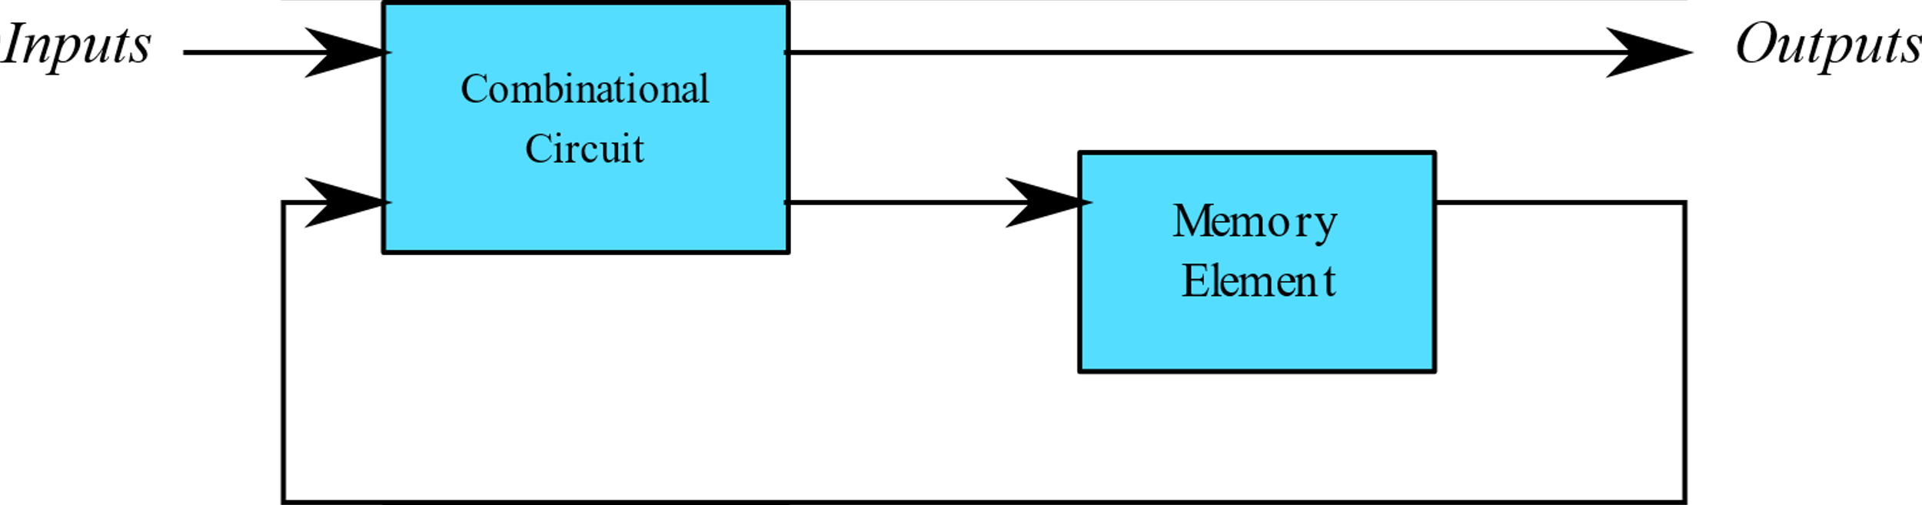
Sequential Circuits
Block Diagram of Sequential Circuit
The output of a sequential circuit depends on
Inputs and
Present state of the storage elements
The Next state of storage elements is also a function of
Inputs and
Present state of the storage elements
Thus, a sequential circuit is specified by a time sequence of inputs, outputs, and internal states

Slide 6
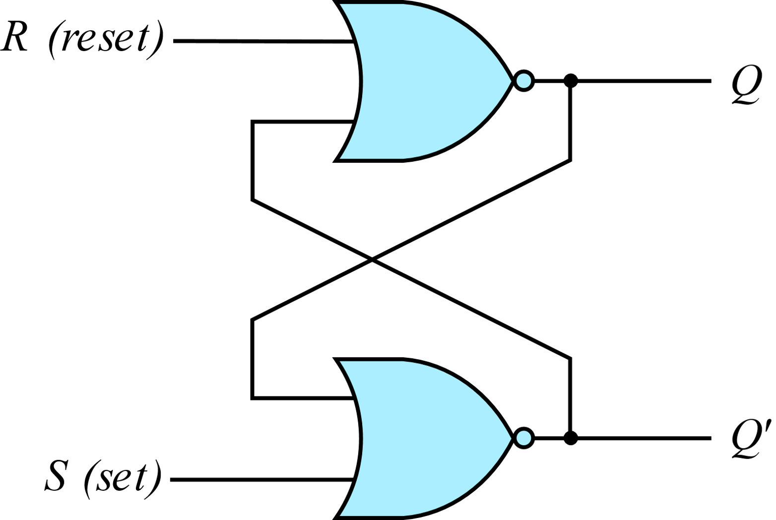
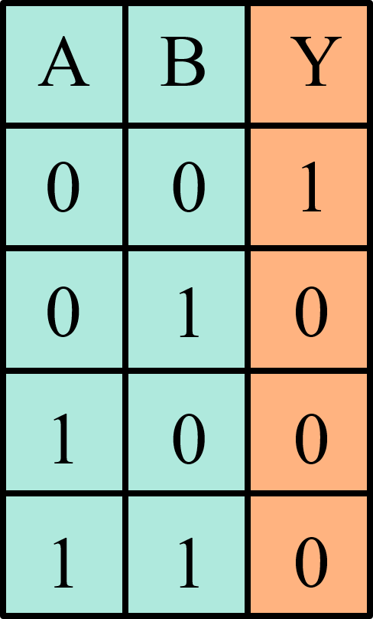
SR Latch
One of the simplest sequential circuits is the SR latch, which is composed of two cross-coupled NOR gates
Truth table of NOR gate can be summarised as: If a NOR gate sees at least one high input, the output is low

Slide 7
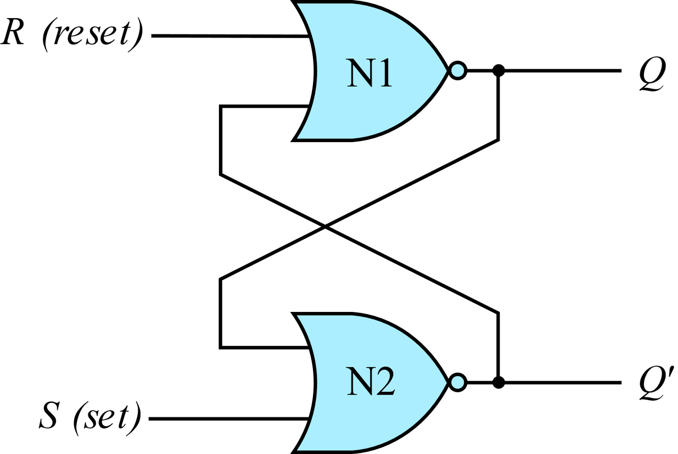
SR Latch
Case I: R = 1, S = 0
N1 sees at least one HIGH input, R, so it produces a LOW output on Q. N2 sees both Q and S as LOW, so it produces a HIGH output on Q’
A good way to understand an unfamiliar circuit is to work out its truth table, so that is where we begin.

Slide 8
SR Latch
Case II: R = 0, S = 1
N1 receives inputs of 0 and Q’ Because we don’t yet know Q’, we can’t determine the output Q.
N2 receives at least one HIGH input, S, so it produces a LOW output on Q’
Now we can revisit N1, knowing that both inputs are LOW, so the output Q is HIGH.

Slide 9
SR Latch
Case III: R =1, S = 1
N1 and N2 both see at least one HIGH input (R or S), so each produces a LOW output. Hence Q and Q’ are both LOW.

Slide 10
SR Latch
Case IV: R =0, S = 0
N1 receives inputs of 0 and Q’
Because we don’t yet know Q’, we can’t determine the output
N2 receives inputs of 0 and Q
Because we don’t yet know Q, we can’t determine the output
Now we are stuck!!!
But we know that Q must either be 0 or 1. So we can solve the problem by checking what happens in each of these subcases.

Slide 11
SR Latch
Case IV (a): R =0, S = 0 Q=0
Because S and Q are LOW, N2 produces a HIGH output on Q’,
Now N1 receives one HIGH input, Q’, so its output, Q, is LOW, just as we had assumed.

Slide 12
SR Latch
Case IV (a): R =0, S = 0 Q=1
Because Q is HIGH produces a HIGH output on Q’,
Now N1 receives one HIGH input, Q’, so its output, Q, is LOW, just as we had assumed.
Summarizing Case IV:
Suppose Q has some known prior value (Qprev) before we enter Case IV. Qprev is either 0 or 1, and represents the state of the system.
When R and S are 0, Q will remember this old value, Qprev, and Q’ will be its complement, Qprev’: This circuit has memory.

Slide 13
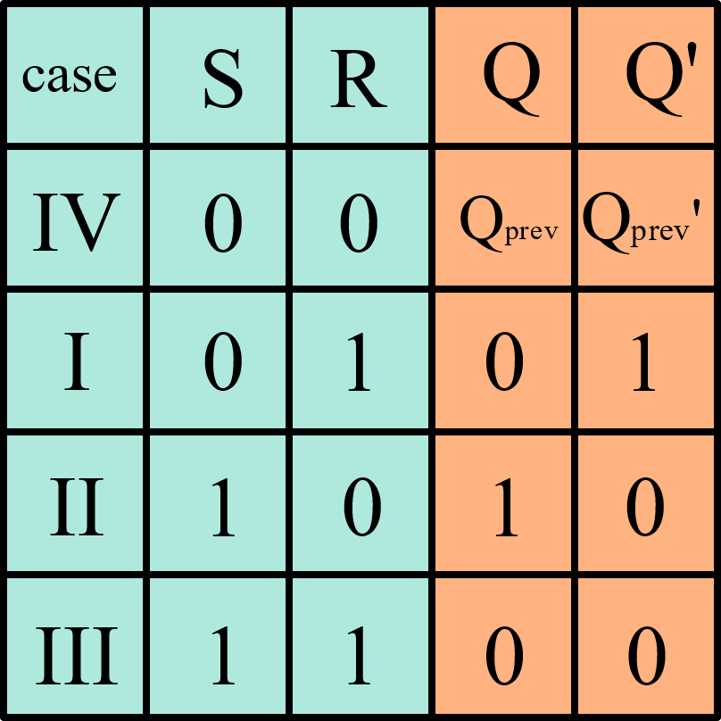
SR Latch

Slide 14










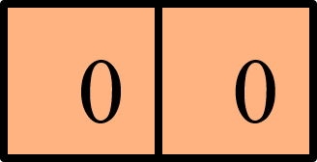

SR Latch
If both inputs R and S simultaneously change from 1 to 0 – We end up in a RACE CONDITION.
That is why SR latch is never allowed to enter S=1,R=1 state and hence it is called FORBIDDEN STATE

Slide 15
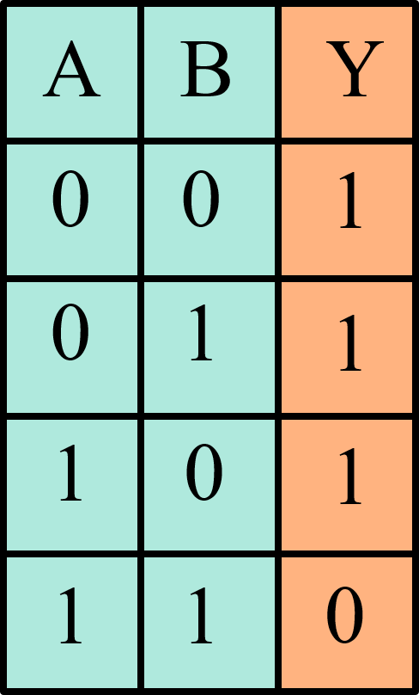
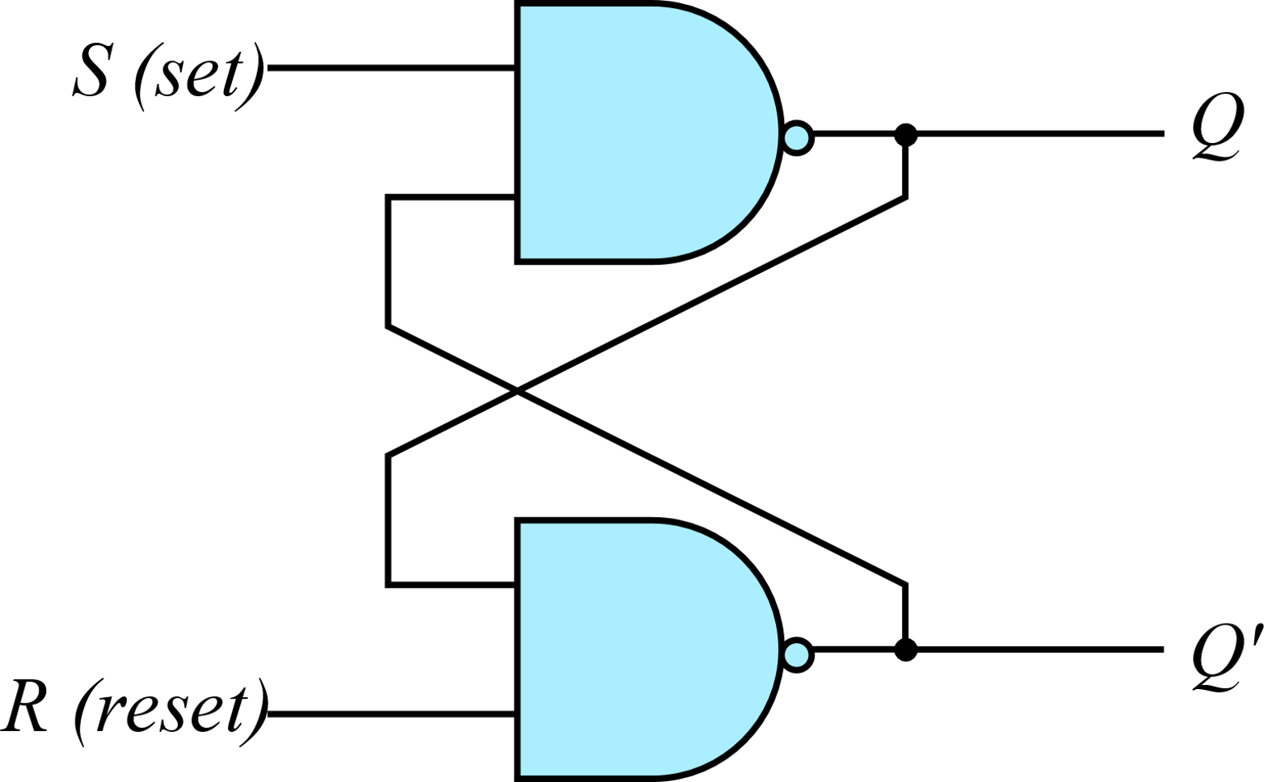
S’R’ Latch
Truth table of NAND gate can be summarised as: If a NAND gate sees at least one low input, the output is high
Doing a similar analysis on NAND gates, we can obtain the truth table of S’R’ Latch

Slide 16
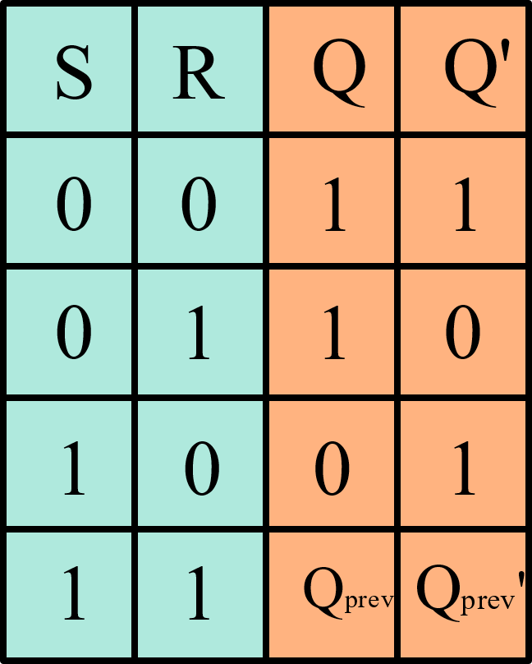
S’R’ Latch
If both inputs R and S simultaneously change from 0 to 1– We end up in a RACE CONDITION.
That is why S’R’ latch is never allowed to enter S=0,R=0 state and hence it is called FORBIDDEN STATE

Slide 17
S’R’ Latch
In comparing the NAND with the NOR latch, note that the input signals for the NAND latch require the complement of those values used for the NOR latch. That is why NAND latch is referred to as S’R’ latch

Slide 18
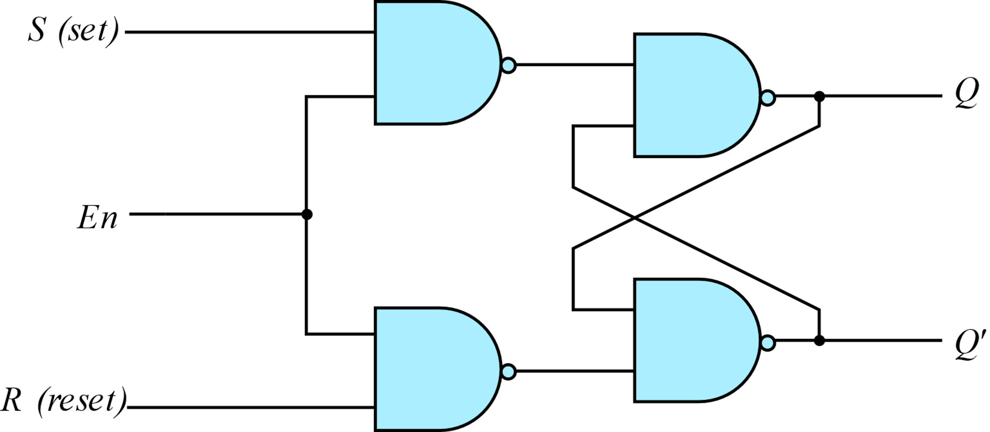
SR Latch with Enable
It consists of the basic S’R’ latch and two additional NAND gates
The control input En acts as an enable signal for the other two inputs
The outputs of the NAND gates stay at the logic-1 level as long as the enable signal remains at 0.
This is the Memory condition for NAND latch

Slide 19
SR Latch with Enable
When En=1, information on S and R is allowed to pass through
When S=1, R=0 and En=1, the output Q is set
When S=0, R=1 and En=1, the output Q is reset
In either case, when En returns to 0, the circuit remains in its current state
Moreover, when En = 1 and both the S and R inputs are equal to 0, the state of the circuit does not change

Slide 20
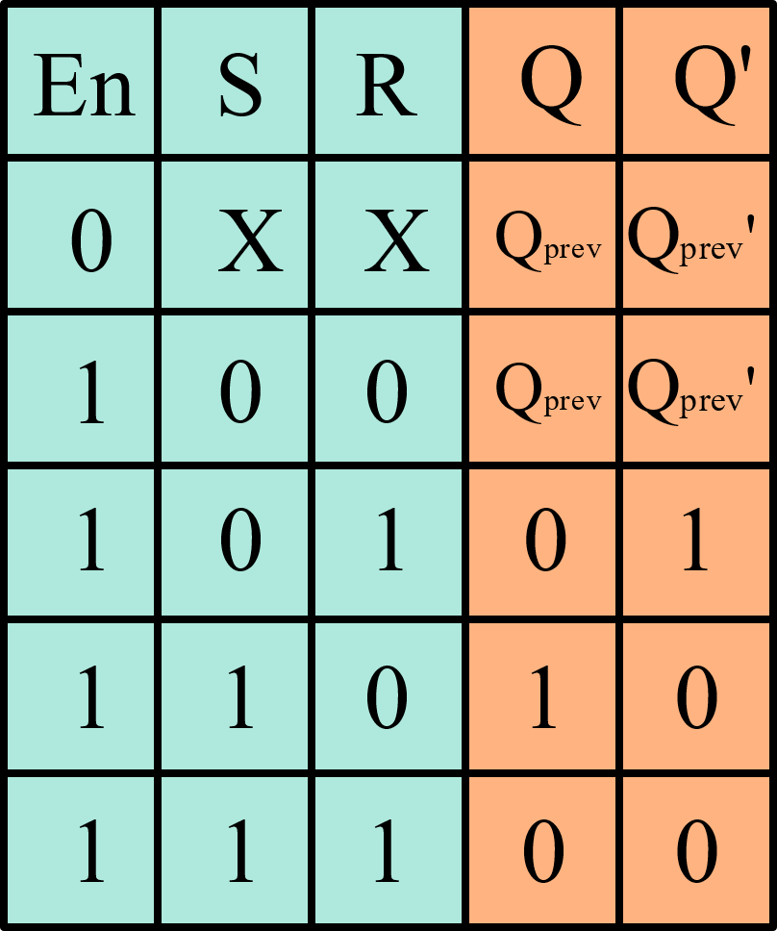
SR Latch with Enable

Slide 21
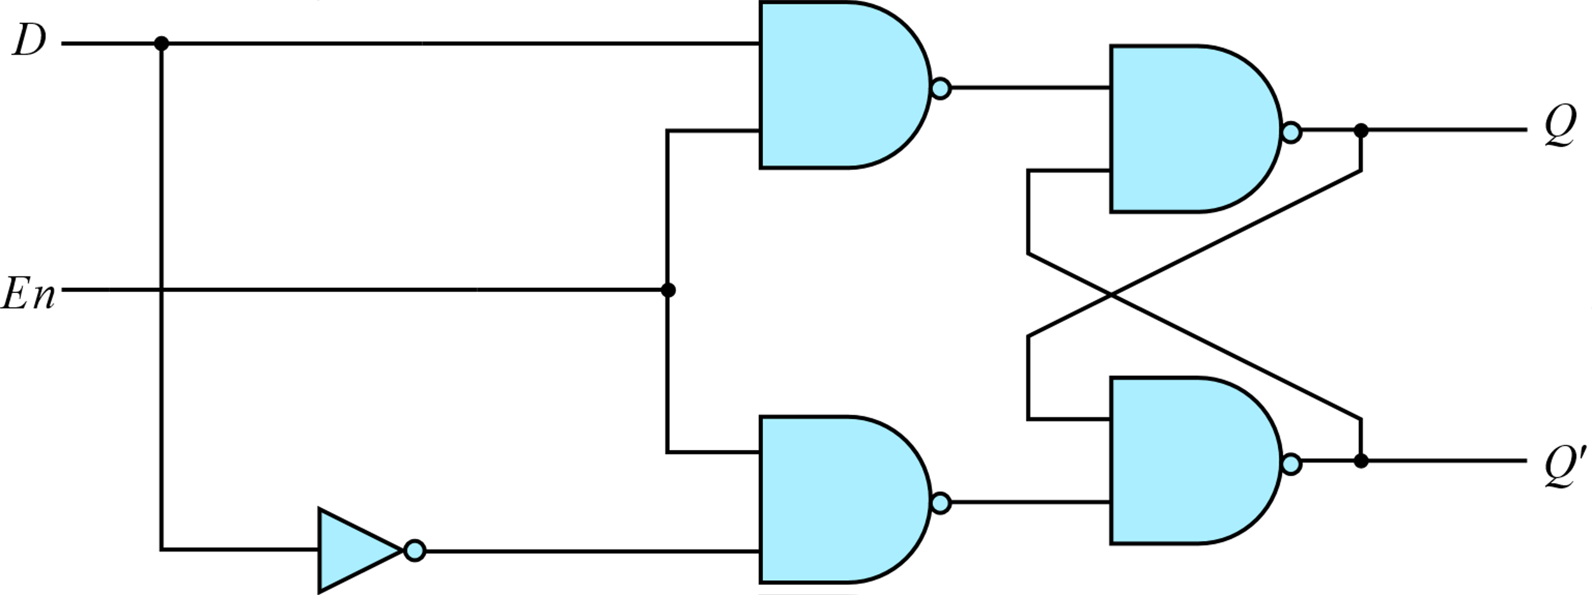
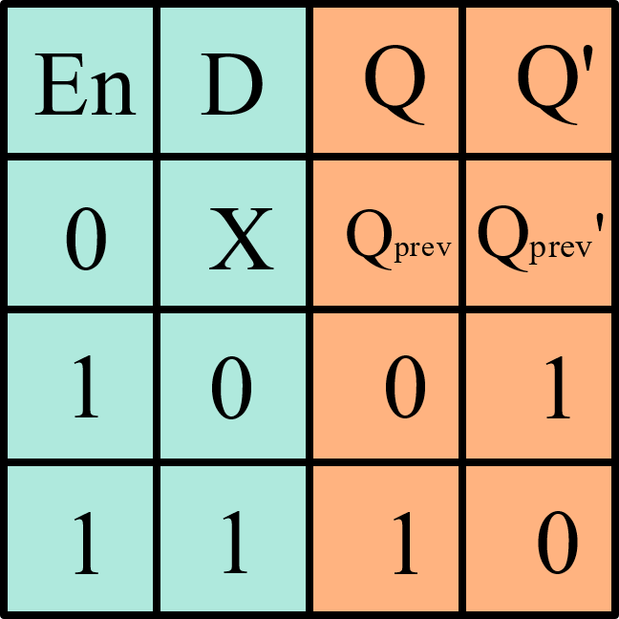
D Latch
One way to eliminate the Forbidden condition of the SR latch is to ensure that inputs S and R are never equal to 1 at the same time.
This latch has only two inputs: D (data) and Enable. The D input goes directly to the S input, and its complement is applied to the R input

Slide 22


Slide 23
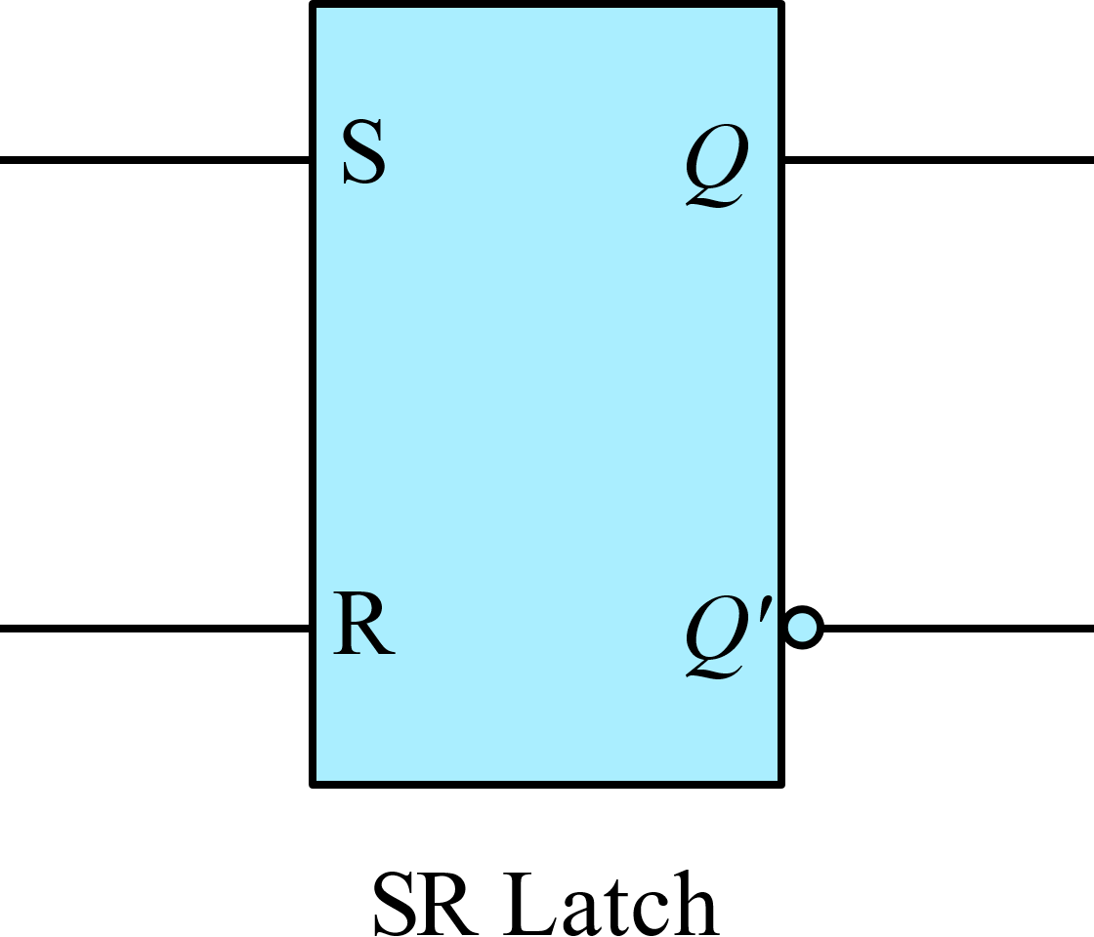
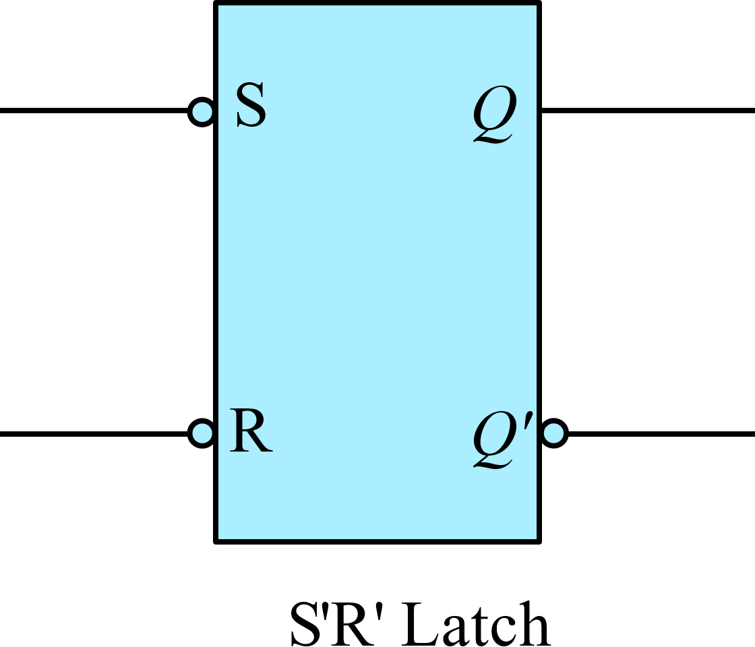
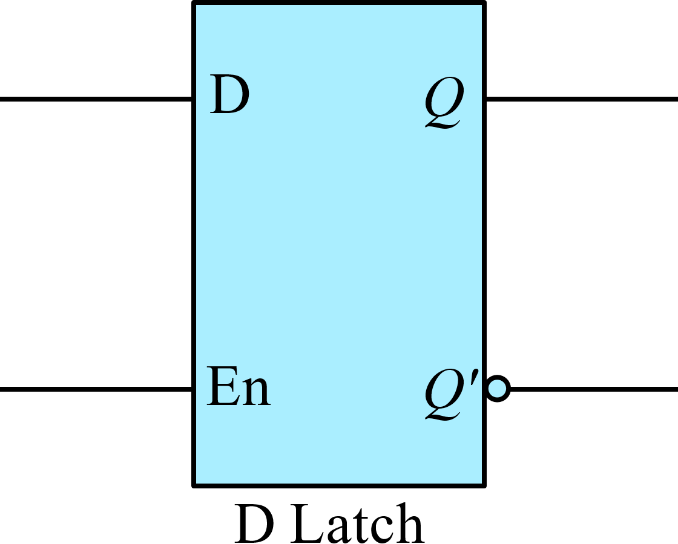
Graphic Symbols of Latches

Slide 24
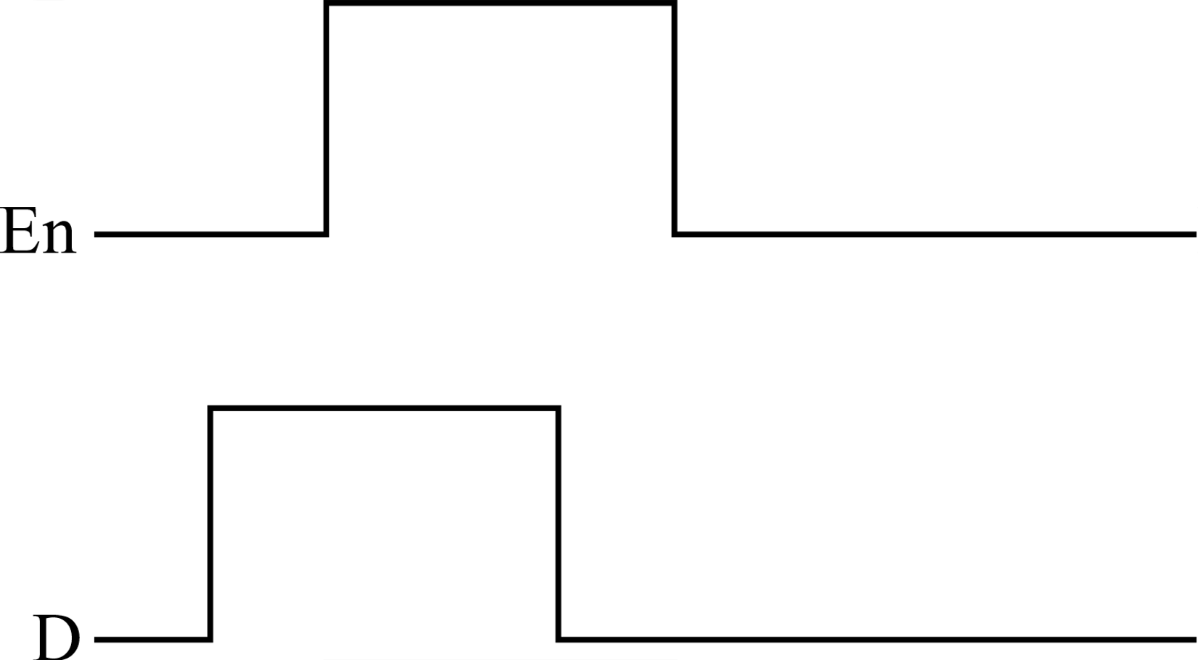

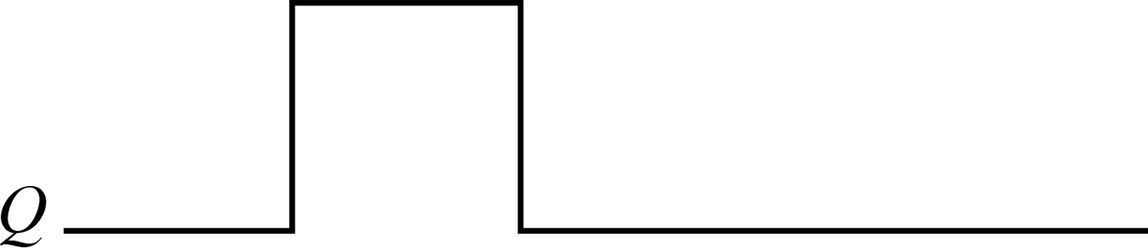
Latches and Levels
The state transitions of the latches start as soon as the clock pulse (Enable) changes to the logic-1 level. Since latches respond to levels, they are called LEVEL SENSITIVE
It is useful to update the output only at a specific instant in time instead of changing whenever level(Enable) is high. This leads us to Flip-Flops

Slide 25


Flip - Flops
What are flip flops?

Slide 26
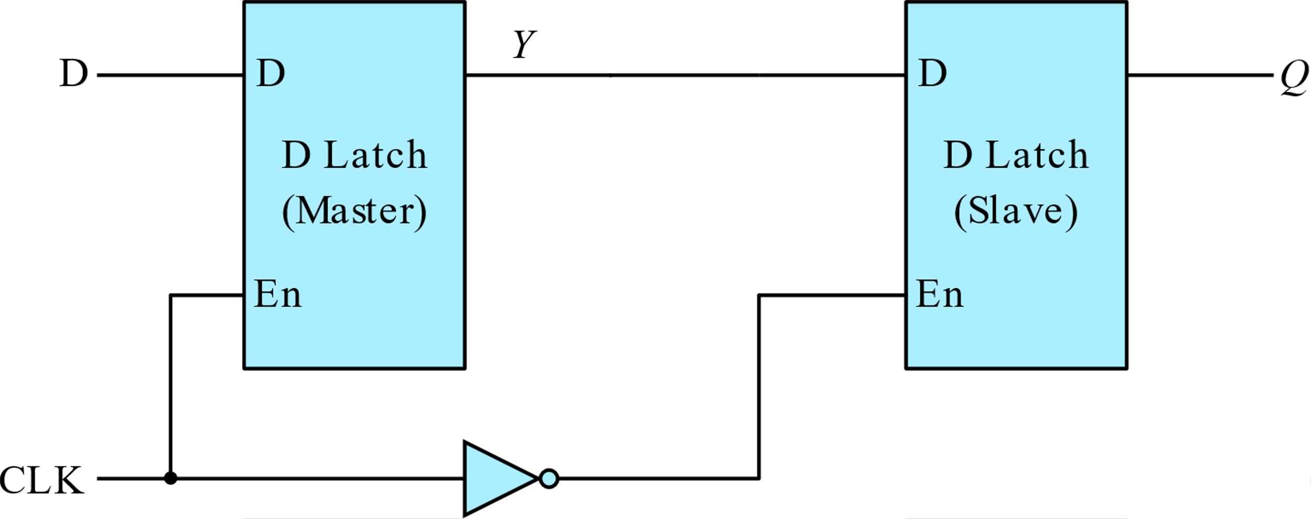

Edge Triggered D- Flip Flop
Master-Slave D- Flip Flop
D flip flops can be triggered on positive or negative edge. The above is a negative edge triggered flip-flop, which means Output changes on falling edge of the clock

Slide 27
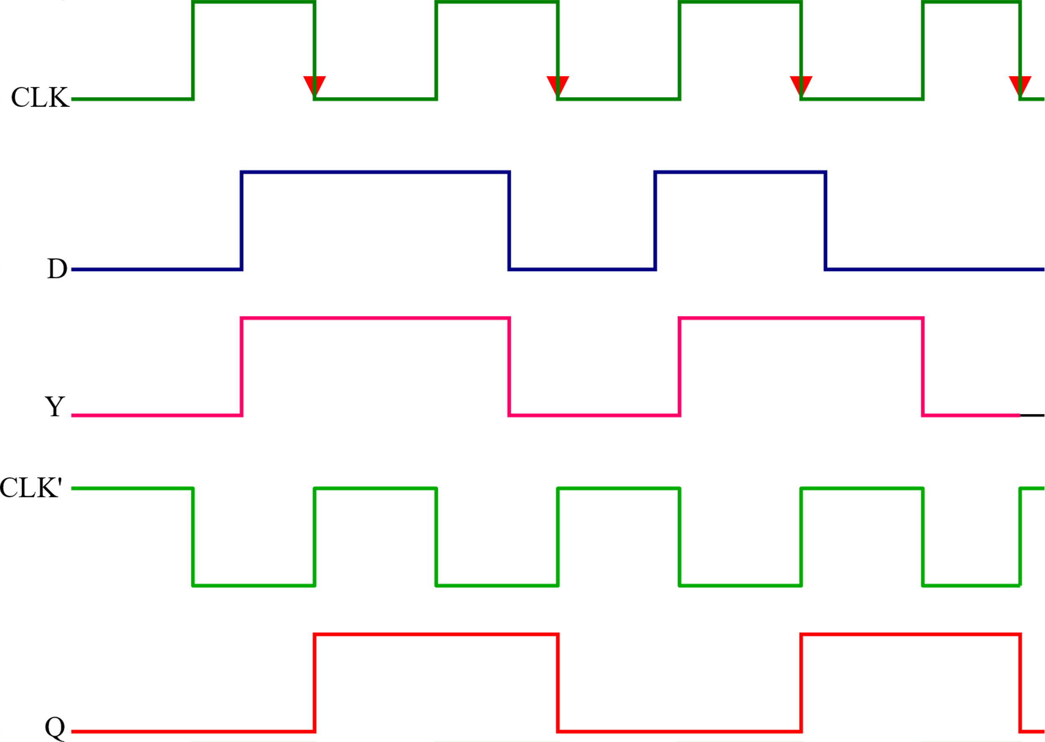
Edge Triggered D- Flip Flop

Slide 28
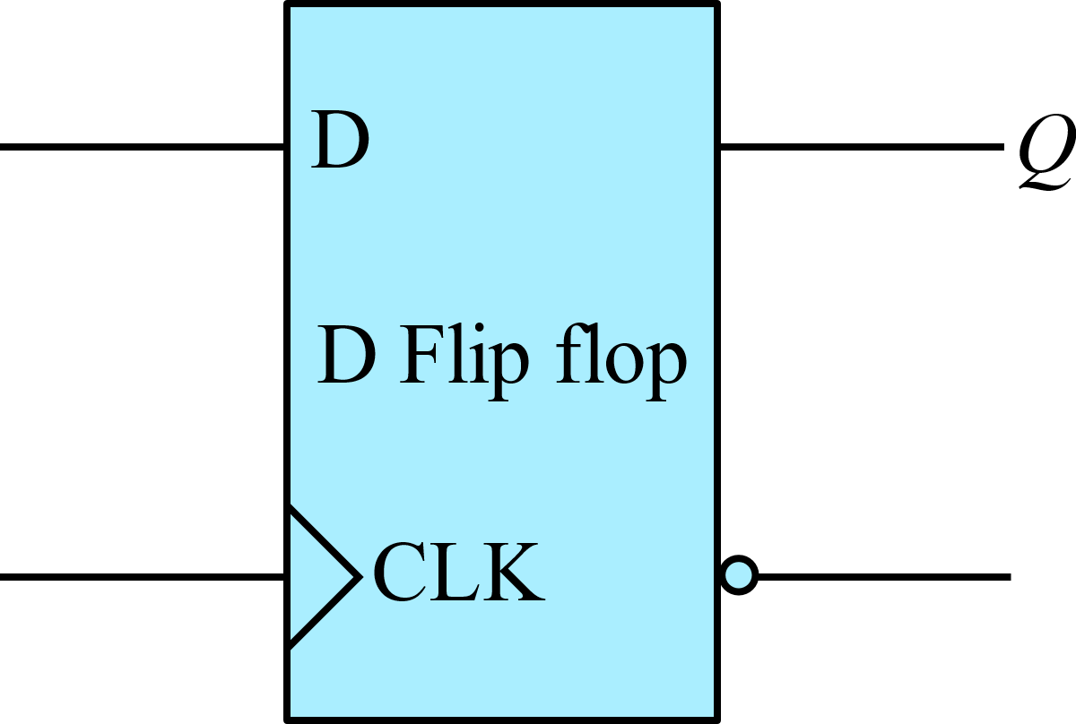
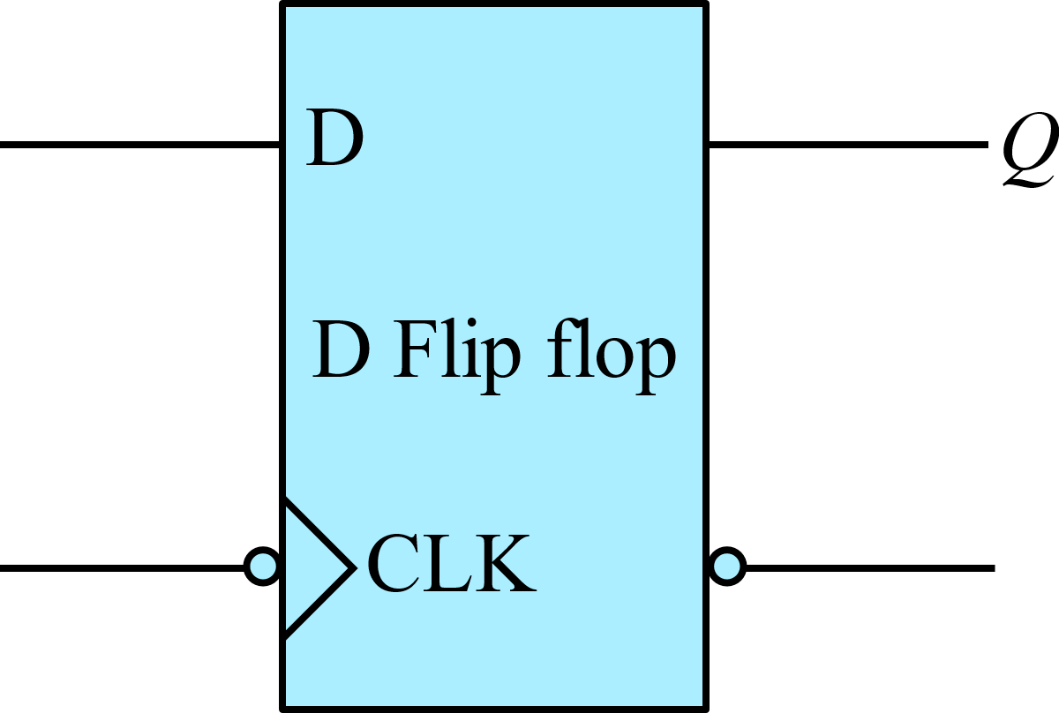

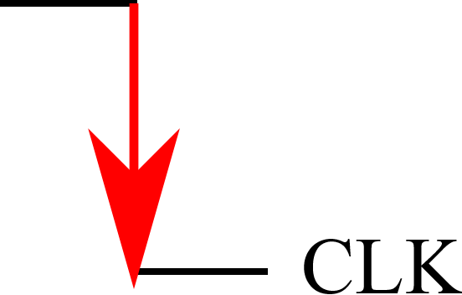
Graphic Symbols of Flip Flops
Positive Edge triggered flip flop
Negative Edge triggered flip flop

Slide 29
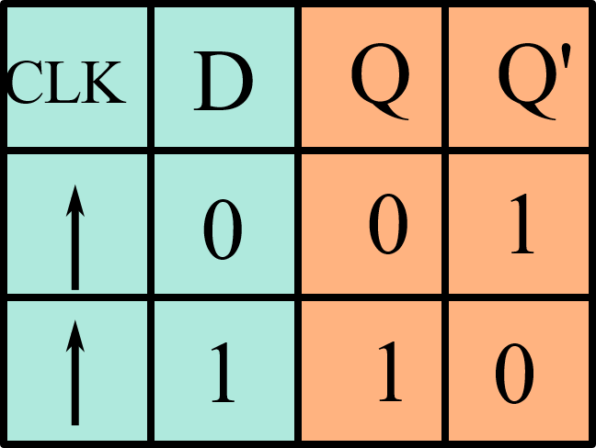
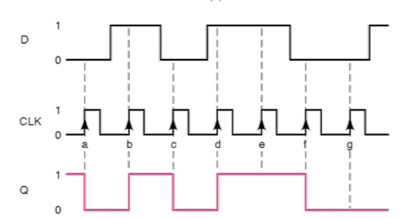
Graphic Symbols of Flip Flops

Slide 30
Other Flip Flops
Apart from the edge triggered D Flip Flop, there are other types of flip flops, namely JK flip flop and T flip flop
JK and T Flip Flops can be constructed with the help of D flip flop and some external logic
The logical properties of a flip flop are defined by a characteristic table
Characteristic Tables define the next state (i.e., the state that results from a clock transition) as a function of the inputs and the present state

Slide 31
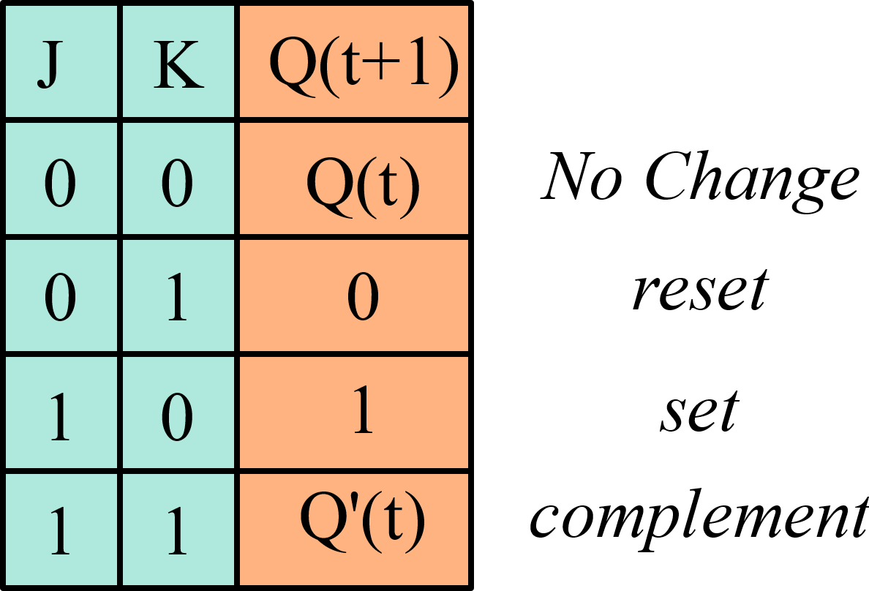
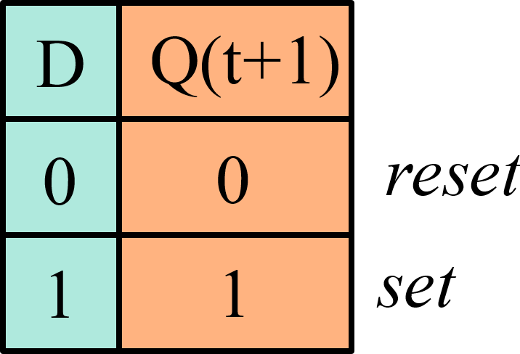
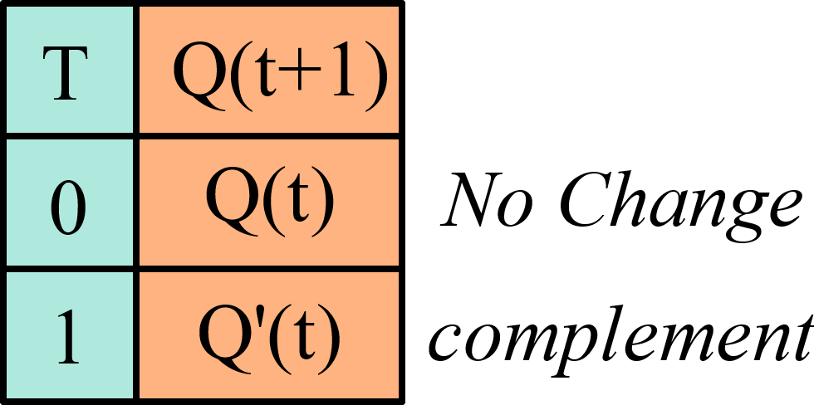
Characteristic Tables
Characteristic Table of D Flip Flop
Characteristic Table of JK Flip Flop
Characteristic Table of T Flip Flop

Slide 32
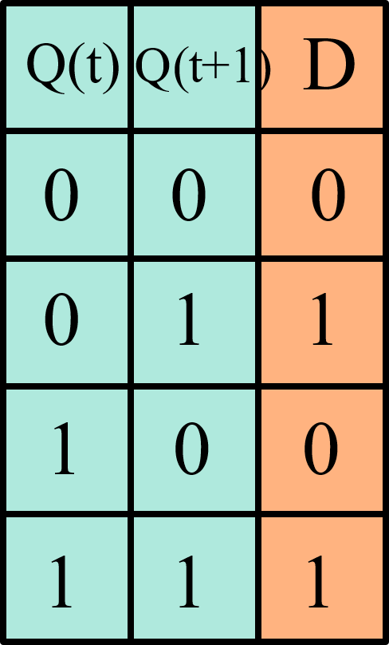
Excitation Tables
An excitation table shows the inputs that are necessary to generate a particular next state when the current state is known
The current state and next state are next to each other on the left-hand side of the table, and the inputs needed to make that state change happen are shown on the right side of the table.
Excitation Table of D – Flip Flop

Slide 33
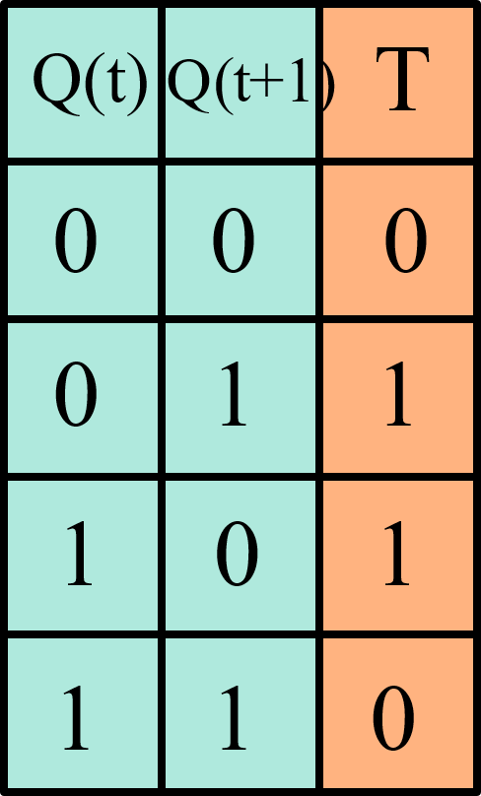
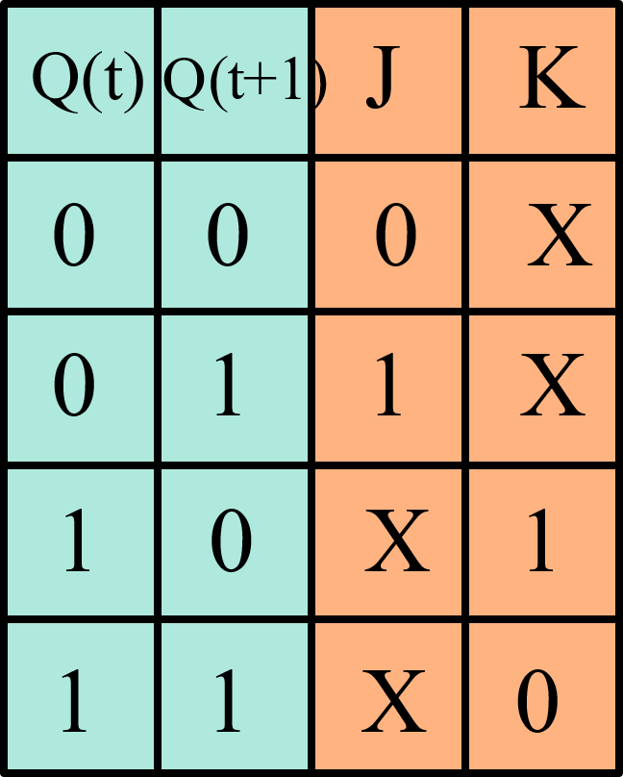
Excitation Tables
Excitation Table of T – Flip Flop
Excitation Table of JK – Flip Flop

Slide 34
JK Flip Flop from D Flip Flop
While constructing one type of flip flop from the other the following steps are to be followed
1) The next state of the flip flop that is available to us needs to be evaluated --- In this case next state of D flip flop i.e., Q(t+1)
2) This next state should be evaluated as a function of inputs of the required flip flop (In this case, JK) and present state of the available flip flop (In this case D)
In summary, to construct JK Flip flop from D flip flop, we need to evaluate the next state of D flip flop in terms of JK and present state of D i.e., Q(t)

Slide 35



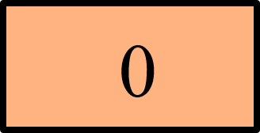

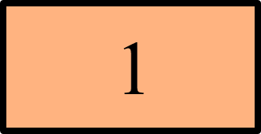

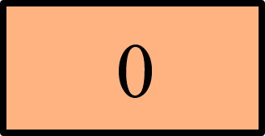
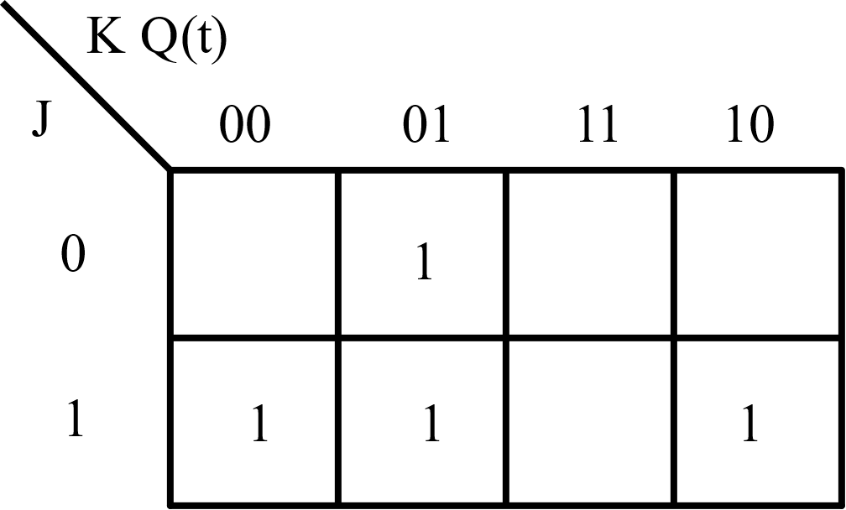

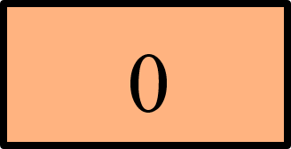


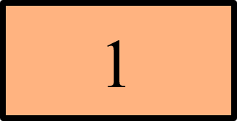




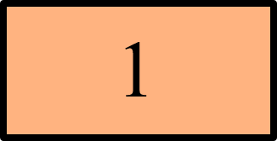

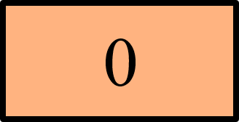
JK Flip Flop from D Flip Flop
D(J,K,Q(t)) = ∑ (1,4,5,6)
D = $K^{′}Q+JQ′$

Slide 36
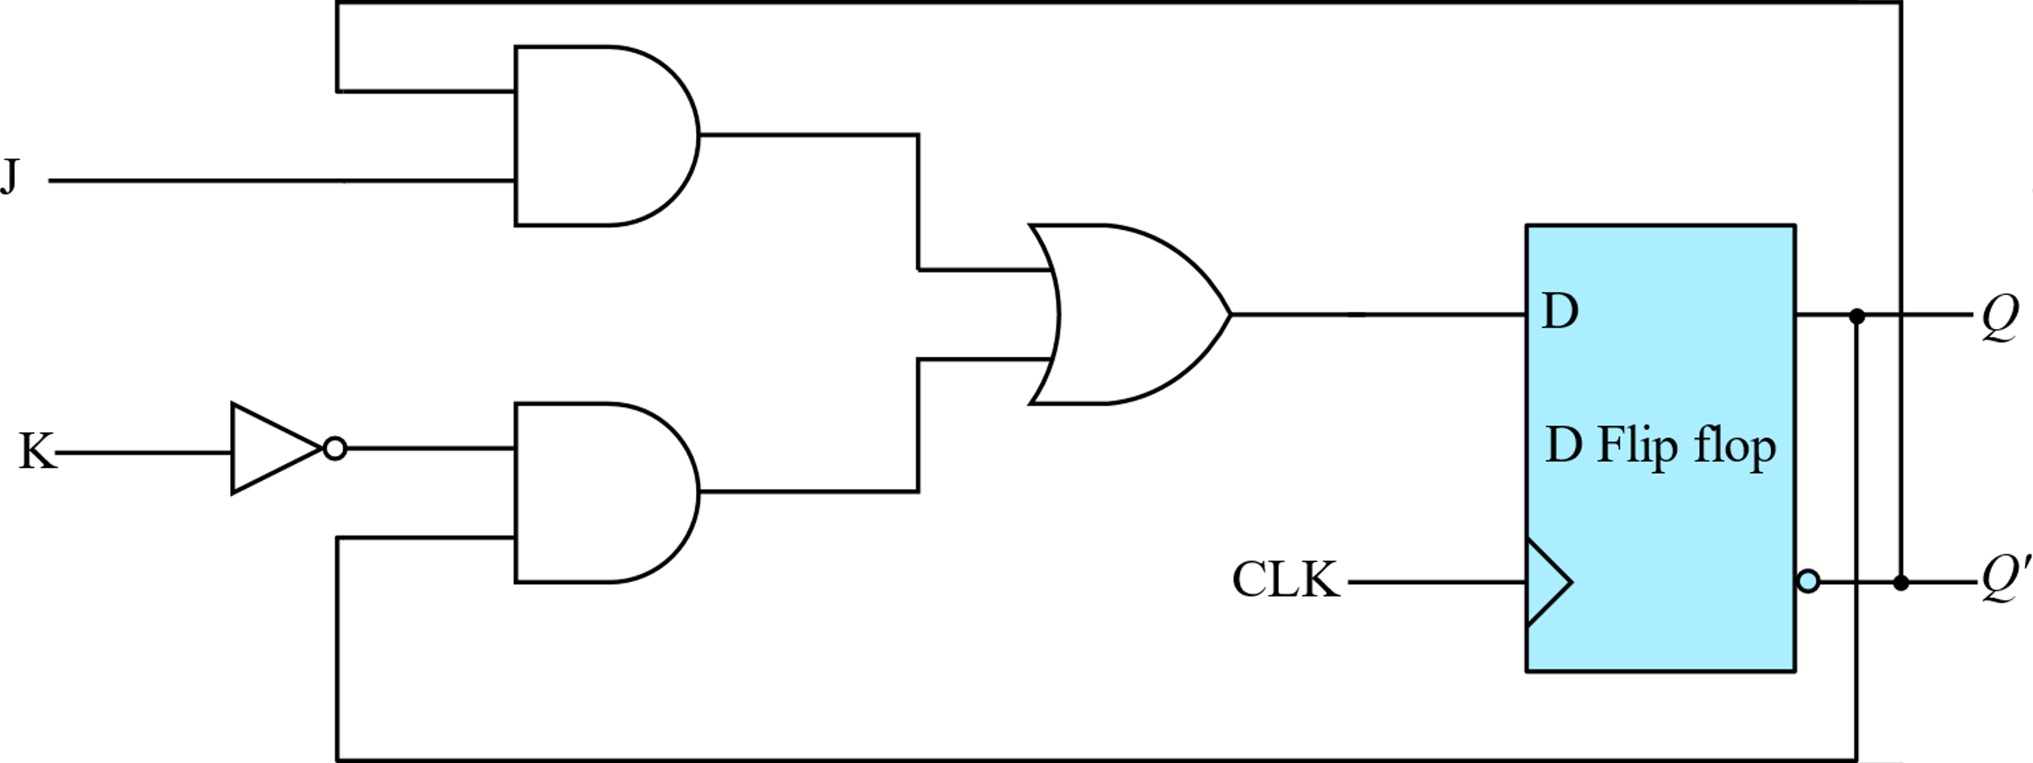
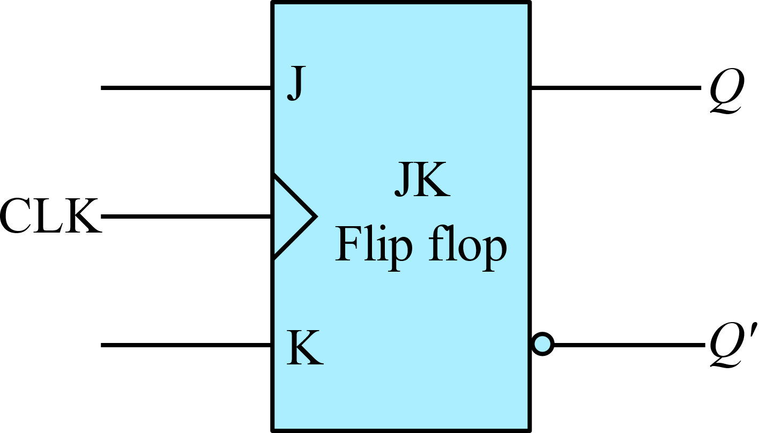
JK Flip Flop from D Flip Flop

Slide 37
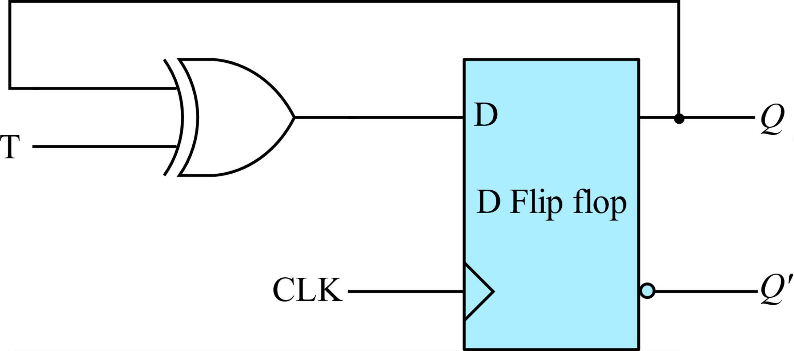





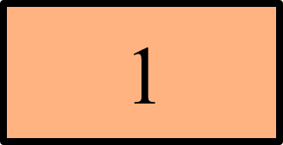

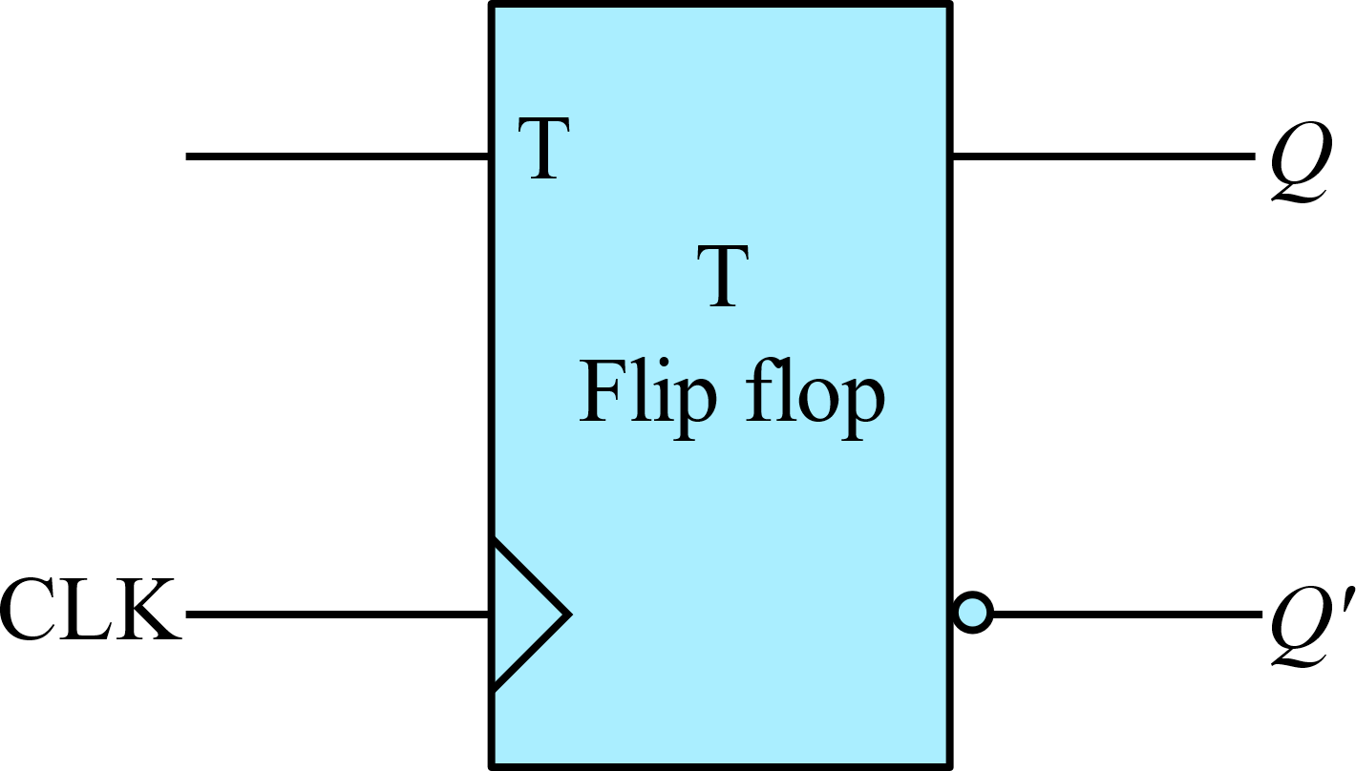
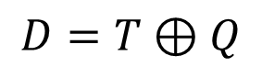
T Flip Flop from D Flip Flop
$$D=T⊕Q$$

Slide 38
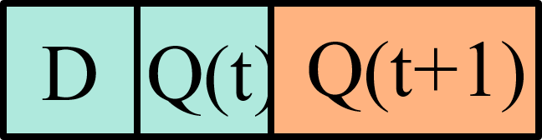

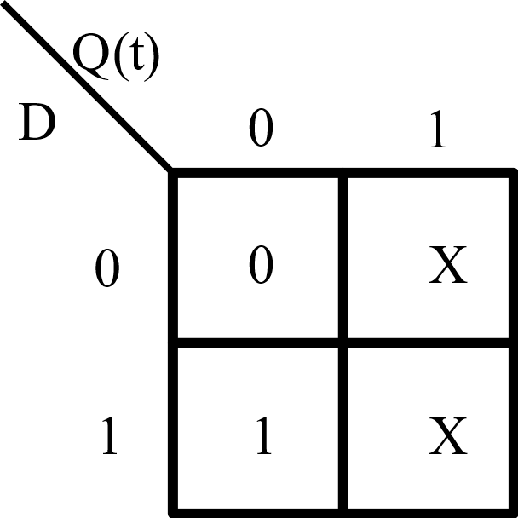
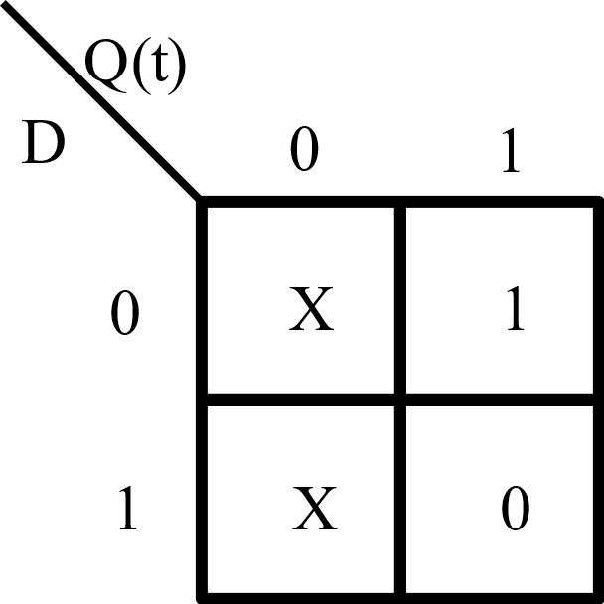


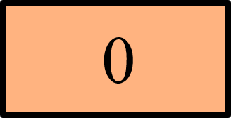



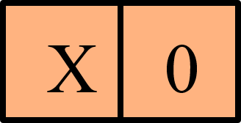

D Flip Flop from JK Flip Flop
For K
For J
K =D’
J =D

Slide 39






T Flip Flop from JK Flip Flop
For K
For J
K =T
J =T

